Slide 1
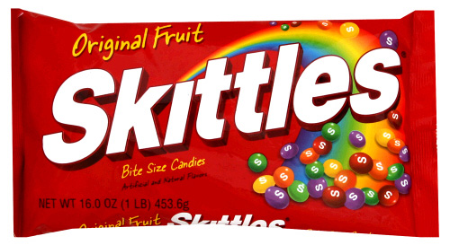
Is the number of red Skittles in a regular sized bag of Skittles brand candies related to the total number of Skittles in a bag?
Statistics- Summer Semester 2011 Group 13
Liz Sherman
Rachel Wright
Chalyse Mason
Lisa Victorine
Kristi Miller

Slide 2
Research plan:
Our group started out with seven members. Each of the seven people in the group was to buy five regular sized bags of Skittles for a group total of 35.
Out of each of our five bags, we were to count the total number of red Skittles as well as the total number of Skittles. This would then give us the ratio of the number of red Skittles per total number of Skittles per bag.
After this plan had been decided and data collection had already started, two of our group members decided to drop the class, leaving us with only five people. The five remaining people did a great job absorbing the extra work but we decided that it was too late to rearrange our project too greatly.
This decision resulted in us using a group total of 29 bags of Skittles for data collection and analysis, instead of 35 bags of Skittles. We kept the same method of data collection as mentioned above, except four of the group members counted six bags of Skittles and one counted five bags. A summary and analysis of our data will be seen in following slides.

Slide 3
Total Group Data
Data Table
 | 1st Quantitative Variable (X) | 2nd Quantitative Variable (Y)
Bag | # or Reds in Bag | # of Total Skittles in Bag
1 | 16 | 60
2 | 12 | 61
3 | 16 | 58
4 | 14 | 59
5 | 19 | 61
6 | 12 | 60
7 | 13 | 66
8 | 13 | 65
9 | 14 | 66
10 | 12 | 63
11 | 13 | 64
12 | 12 | 65
13 | 18 | 61
14 | 6 | 61
15 | 6 | 61
16 | 8 | 60
17 | 9 | 61
18 | 13 | 59
19 | 14 | 61
20 | 18 | 63
21 | 17 | 65
22 | 15 | 60
23 | 9 | 59
24 | 12 | 61
25 | 13 | 58
26 | 13 | 62
27 | 9 | 59
28 | 18 | 63
29 | 18 | 58

Slide 4
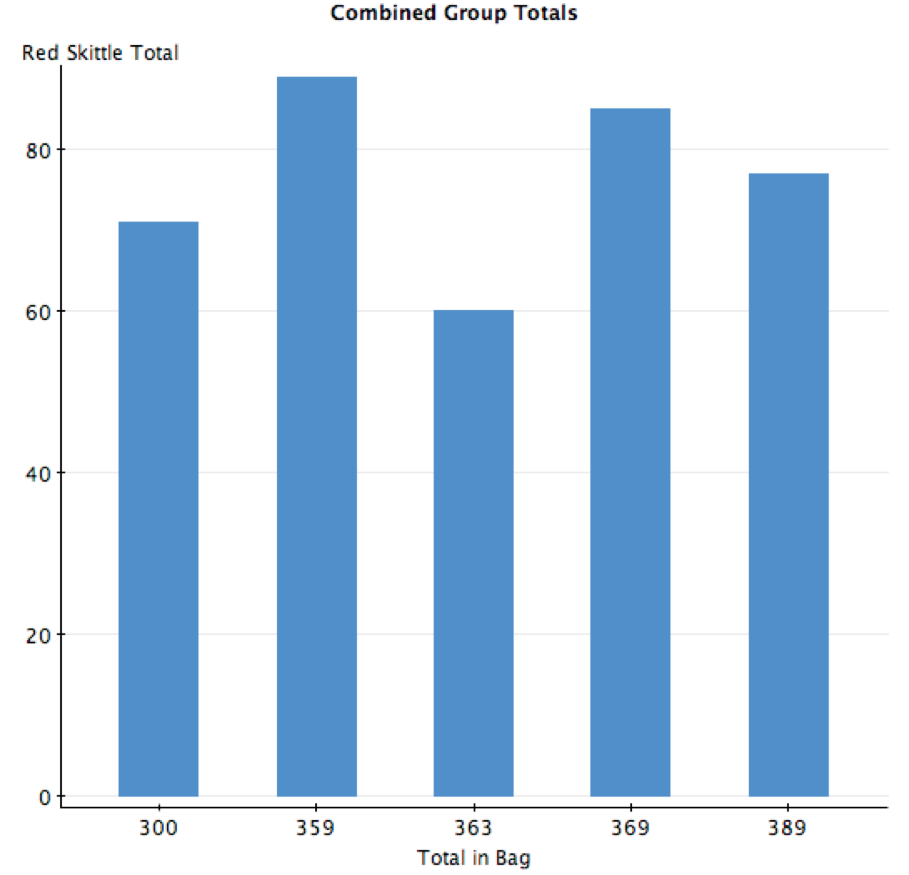
Histogram of combined group data:

Slide 5
Descriptive statistics of total data:
Variable | # or Reds in Bag | # of Total Skittles in Bag
Mean | 13.17 | 61.38
Std. Dev. | 3.55 | 2.41
Max | 19 | 66
Min | 6 | 58
Range | 13 | 8
Mode | 13 | 61
Median | 13 | 61

Slide 9
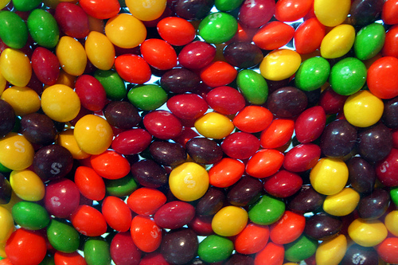
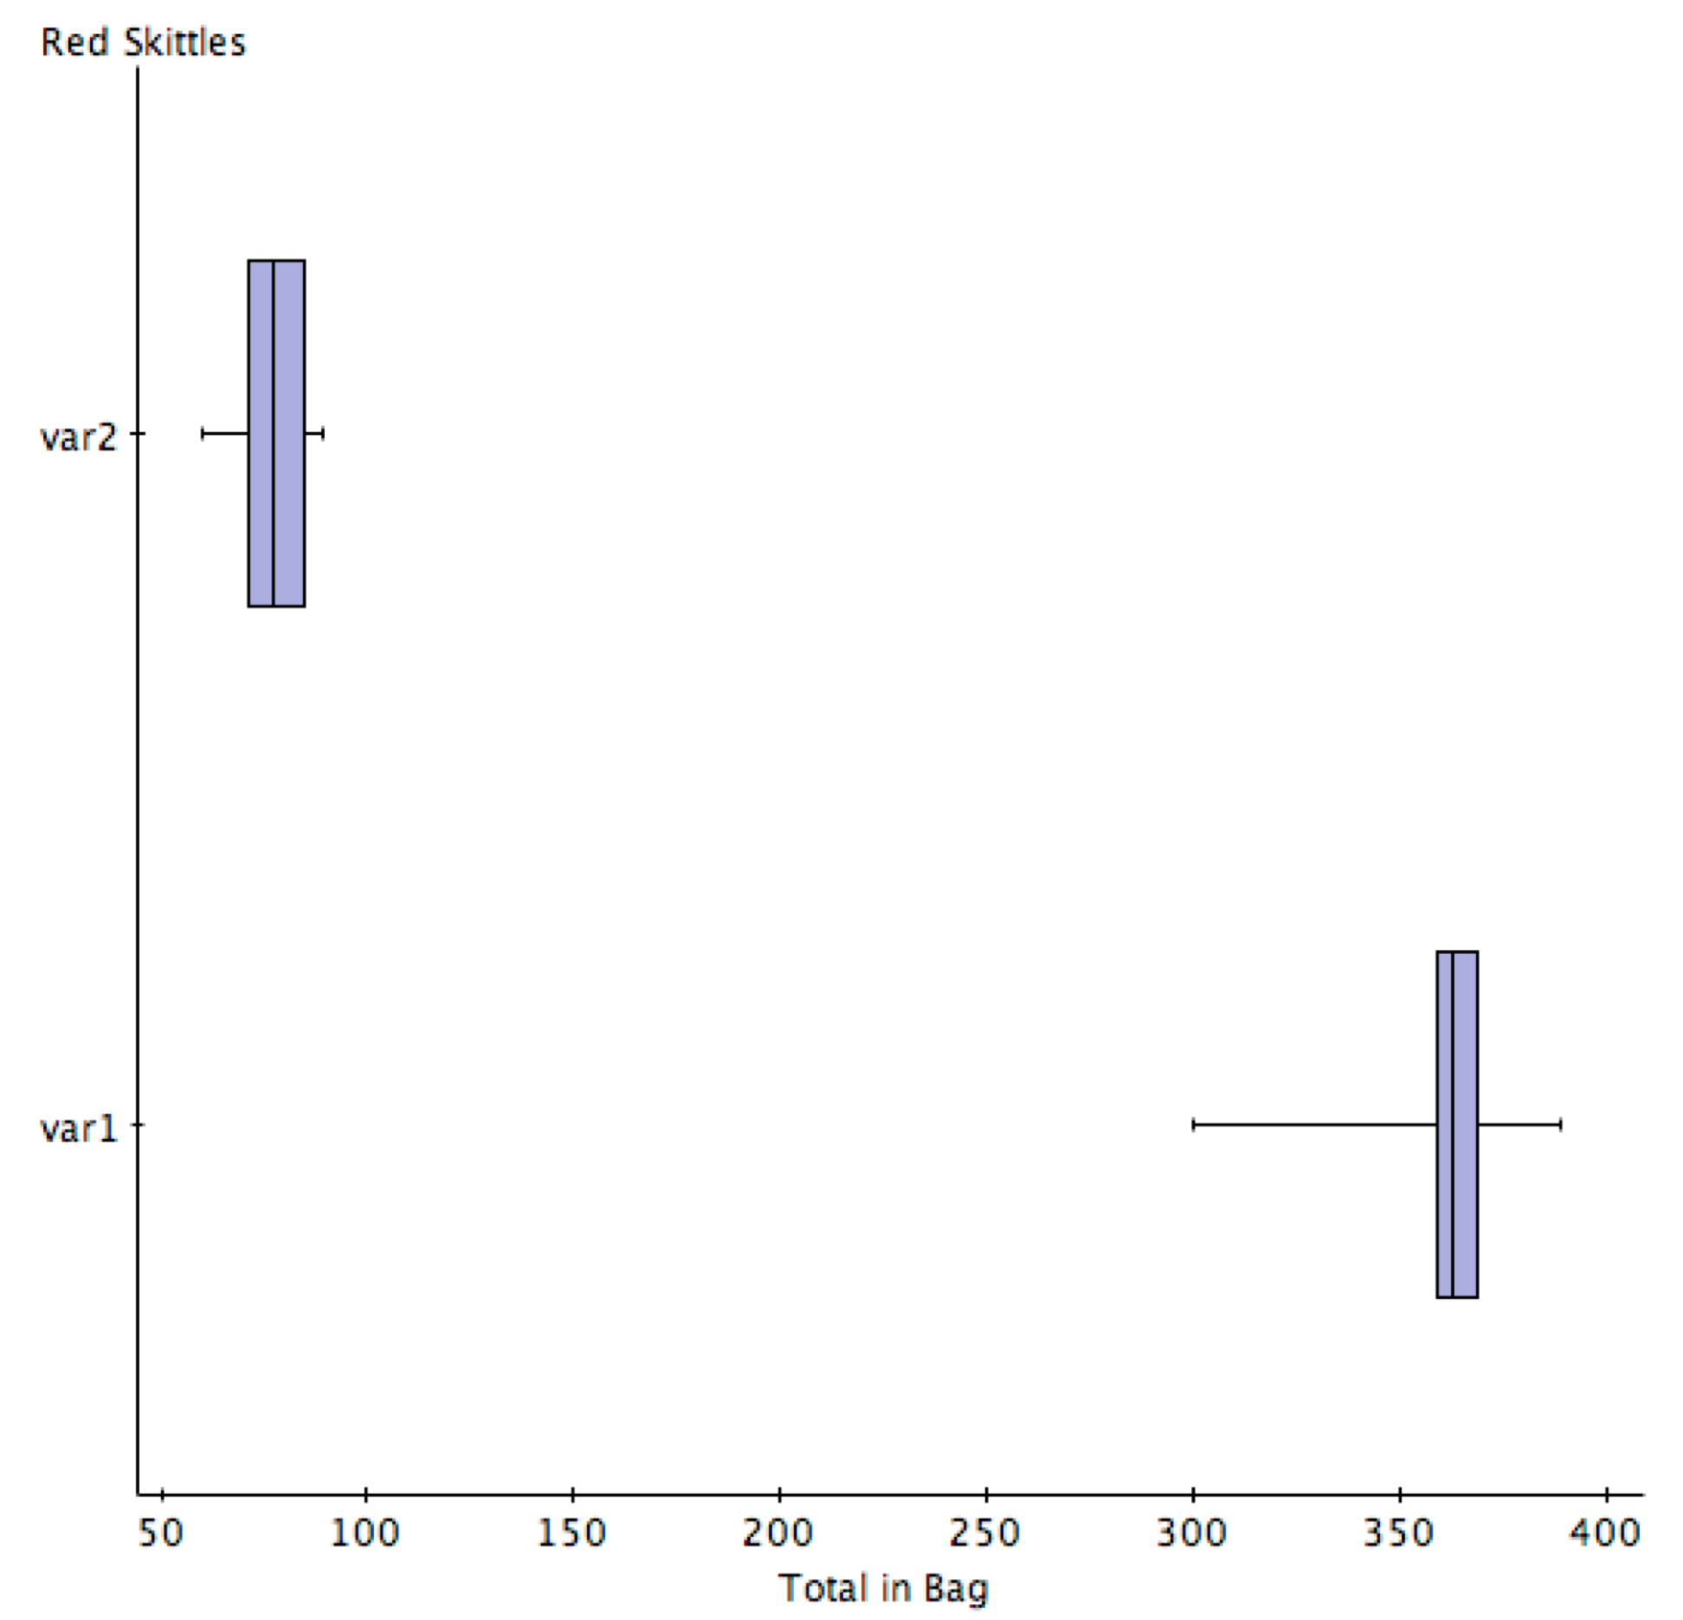
Box Plot of total group data:

Slide 10
According to the Wrigley/Mars Candy Company, manufacturer of Skittles:
**The Wrigley/Mars Co. manufactures 200,000,000 Skittles each day, and they claim each flavor makes up 20% of each bag.
This means there are 40,000,000 RED skittles manufactured each day!!!!
When comparing this statement this with our data…

Slide 11
We have similar results!
Red Skittles | Total Skittles | Relative Freq. for each bag
89 | 359 | .25
77 | 389 | .20
60 | 363 | .17
85 | 369 | .23
71 | 300 | .24
TOTAL | TOTAL | TOTAL FREQ.
382 | 1780 | .21

Slide 12
However, when we used the value R to determine a correlation between the two variables, we only found a very slight positive correlation. As the total number of Skittles in a bag goes up, there is only a slight chance the total number of reds will increase proportionally. That’s why the scatter plot is all over the place (not very linear) and the R-value is not anywhere close to 1.
R= =[ NΣXY - (ΣX)(ΣY) / ([NΣX^2 - (ΣX)^2][NΣY2 - (ΣY)^2])^0.5]
Values for above equation
n | 29
ΣX | 382
ΣY | 1780
ΣXY | 23471
ΣX^2 | 5384
ΣY^2 | 109418
R= | 0.003807327 | Basically there is no correlation (very slight positive)

Slide 13
Our group concluded that an R value of .0038 does not give us a positive enough correlation between the number of red skittles per bag and the total number of Skittles in that bag, and therefore are unrelated.

Slide 14
Possible explanations for our results:
The total number of Skittles in each bag is much more tightly grouped than number of reds in each bag. This is evidenced by the lower standard deviation and smaller range for the total as compared to the same stats for number of reds.
Maybe the factory where Skittles are made cares more about overall quantity because they sell the product per bag.
It’s possible that the biggest concern is to consistently put the same total amount in each bag, despite having a goal of 20% of each color, per bag.

Slide 15
Neither variable is distributed normally. There appears to be two or more “populations” present in the data. This is evidenced by the histograms with more than one “peak.”
This may also be due to the fact that the Skittles were purchased independently and were likely procured by the retailer at different times.
They could be different “batches” of product from the manufacturer. If you could ensure that the same experiment was done with sampling of bags all from the same “batch” you may see more normal distribution of these variables.

Slide 17
This Presentation was brought to you by the following members of group 13:
Liz Sherman- collected data, organized and submitted power point presentation
Chalyse Mason- made project graphs, creative production/ideas
Lisa Victorine- project research, fact finder and project graph creator
Rachel Wright- project production, data collection
Kristi Miller- data collection

